Slide 1

Sentinel Syslog Server

Slide 2

Syslog Data Connector
Azure Sentinel Requirements
Supported Syslog Servers and Platforms
Supported Syslog Formats and Limitations
What is CEF Format
What is the OMS Agent
How to install the Syslog-ng Server on Linux
How to configure the rsyslog
How to deploy the OMS Agent with Python
How to run the Python Troubleshooting Script on a Syslog server

Slide 3
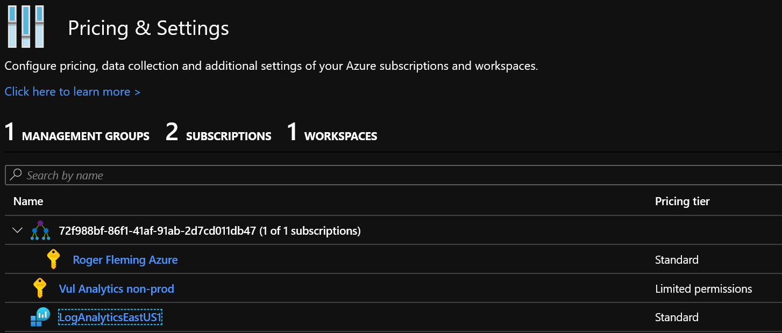
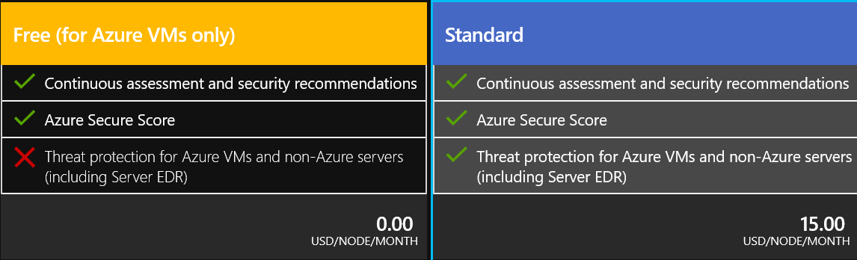
Azure Sentinel Requirements
The Log Analytics workspace must be in standard tier.
Check for this under the Security Center Pricing and Setting page.

Slide 4
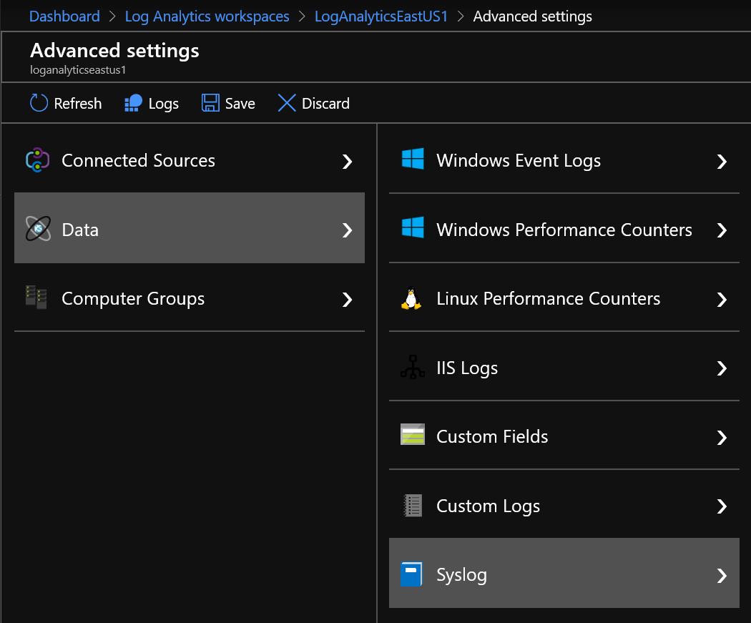
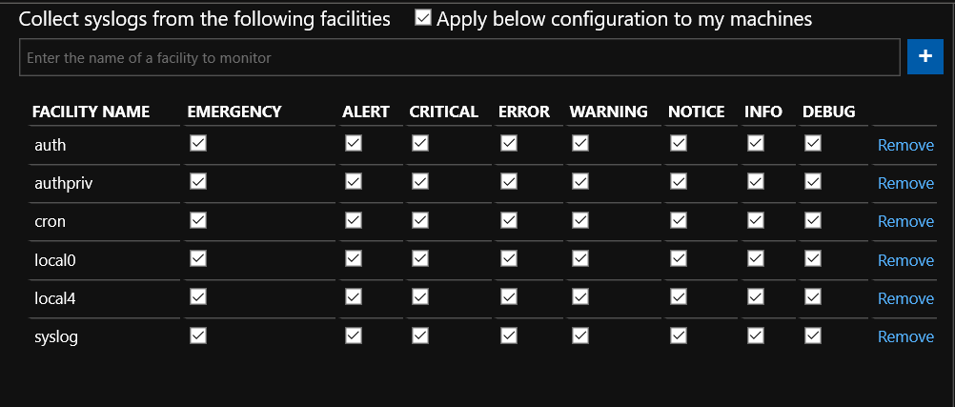
Azure Sentinel Requirements
Enable Data Collection of Syslog Events, most common Syslog, Local0, and Local4
Turn on Syslog Data Collection in the Log Analytics Workspace

Slide 5
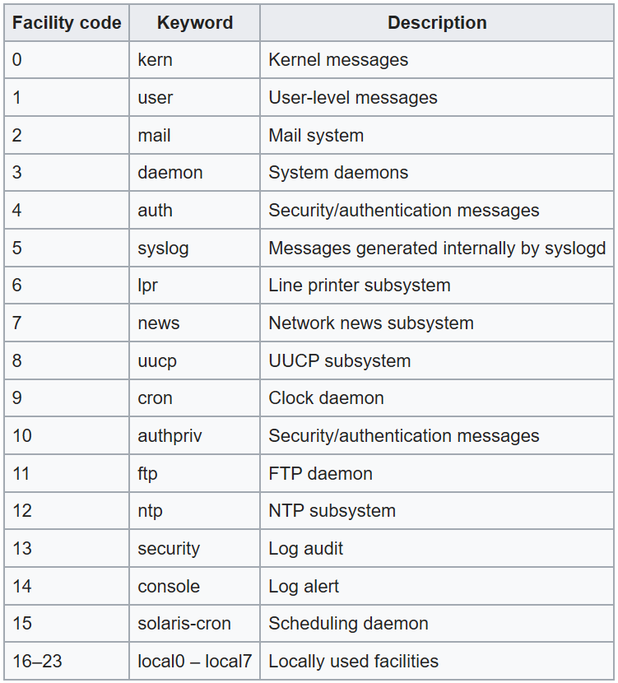
Azure Sentinel Requirements
The following facilities are supported with the Syslog collector:
kern
user
mail
daemon
auth
syslog
lpr
news
uucp
cron
authpriv
ftp
local0-local7
Custom logs are supported:
https://docs.microsoft.com/en-us/azure/azure-monitor/platform/data-sources-custom-logs
OMS Agent can collect from many different Syslog facilities
Syslogs in CEF format and in facility local4 are required so that Sentinel can process them as Common Security Logs

Slide 6
Supported Syslog Servers and Platforms
Azure Sentinel supports the following Syslog Server implementations
Rsyslog
Syslog-NG
Supported Linux Operating Systems
Amazon Linux 2017.09 (x64)
CentOS Linux 6 (x86/x64) and 7 (x64)
Oracle Linux 6 and 7 (x86/x64)
Red Hat Enterprise Linux Server 6 (x86/x64) and 7 (x64)
Debian GNU/Linux 8 and 9 (x86/x64)
Ubuntu 14.04 LTS (x86/x64), 16.04 LTS (x86/x64), and 18.04 LTS (x64)
SUSE Linux Enterprise Server 12 (x64) and 15 (x64)

Slide 7
Supported syslog formats and limitations
OMS Agent can process both Syslog and CEF formatted logs
Only CEF formatted logs can be used for Common Security Logs
Syslogs can be used for Syslog facility logging. Custom reports and alerts will have to be created by the customer.

Slide 8
What is the CEF format
Common Event Format (CEF) is a Logging and Auditing file format and is an extensible, text-based format designed to support multiple device types by offering the most relevant information.
Message syntaxes are reduced to work with ESM normalization. Specifically, Common Event Format defines a syntax for log records comprised of a standard header and a variable extension, formatted as key-value pairs.
Common Event Format can be used with on-premise devices.
Common Event Format can also be used by cloud-based service providers.
Common Event Format is probably the widest used Logging and Auditing file format.

Slide 9
What is the OMS Agent
The Azure Log Analytics agent, previously referred to as the Microsoft Monitoring Agent (MMA) or OMS Linux agent, was developed for comprehensive management across on-premises machines, computers monitored by System Center Operations Manager, and virtual machines in any cloud. The Windows and Linux agents attach to an Azure Monitor and store collected log data from different sources in your Log Analytics workspace, as well as any unique logs or metrics as defined in a monitoring solution.

Slide 10
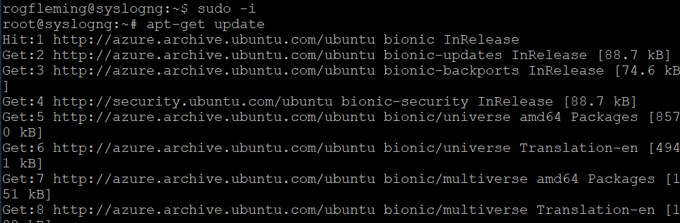
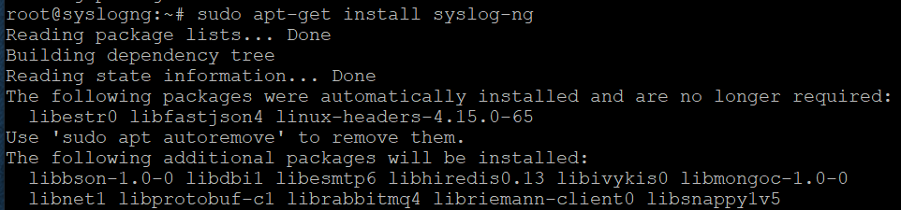
How to install the syslog-ng server on Linux
In order to install and setup syslog-ng server it must be installed on a supported operating system. Refer to specific installation process by OS platform. https://www.syslog-ng.com/community/tags/install
Installation process for syslog-ng on Ubuntu or Debian
sudo apt-get update
sudo apt-get install syslog-ng
Type y and press enter, the install will take a while, get a drink or something.

Slide 11
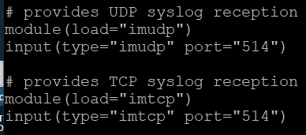
How to configure the rsyslog server
rsyslog is already installed on linux Distributions
To allow rsyslog to listen on tcp and udp port 514 uncomment the following lines in the /etc/rsyslog.conf
restart the rsyslog process: service rsyslog restart

Slide 12
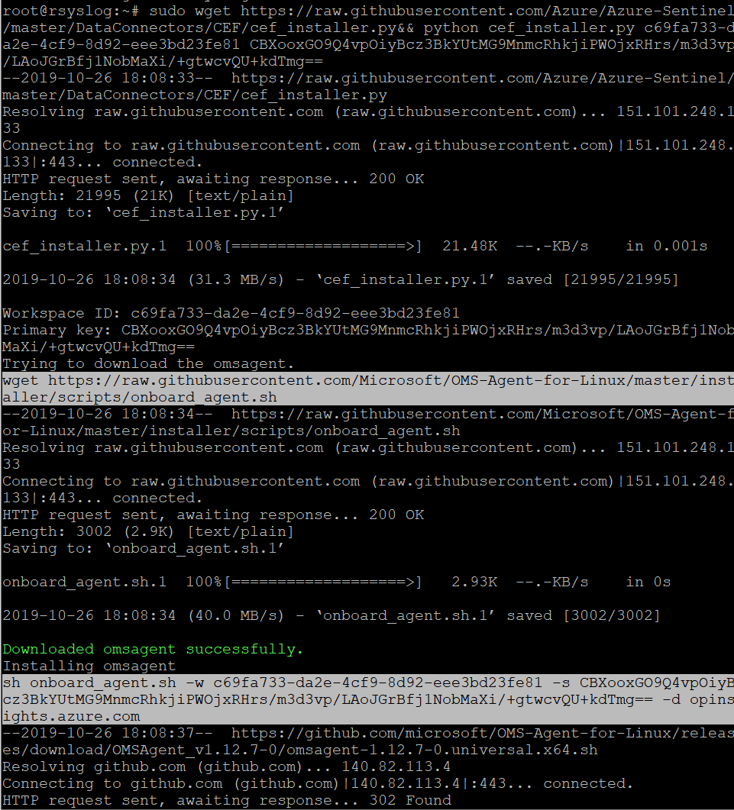
How to deploy the OMS Agent with a Python script
Note: not sure if you need to turn off Auto Provisioning to run this process. I have not tested it yet. I have always turned it off to not create any conflicts.
The command: Change the parameters values according to WorkspaceID and WorkspaceKEY
sudo wget https://raw.githubusercontent.com/Azure/Azure-Sentinel/master/DataConnectors/CEF/cef_installer.py&& python cef_installer.py <WorkspaceID> <WorkspaceKEY>
This script works with Syslog-ng and Rsyslog Syslog Servers.

Slide 13
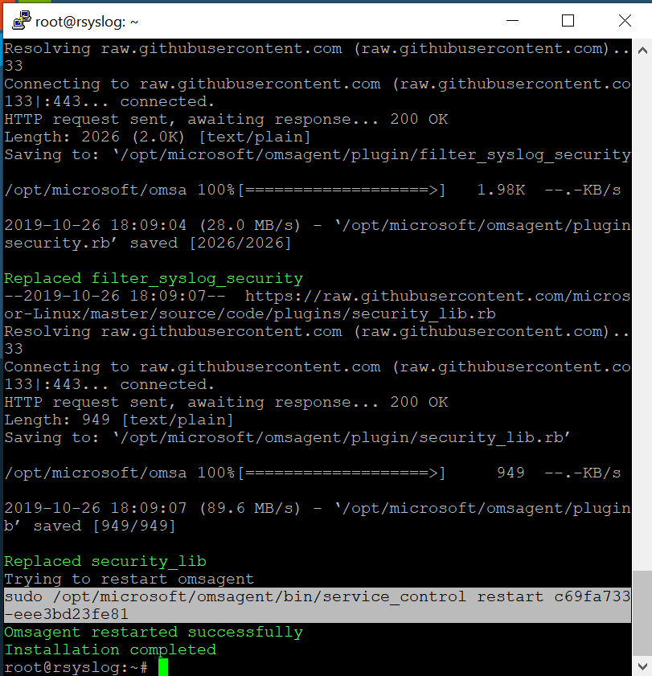
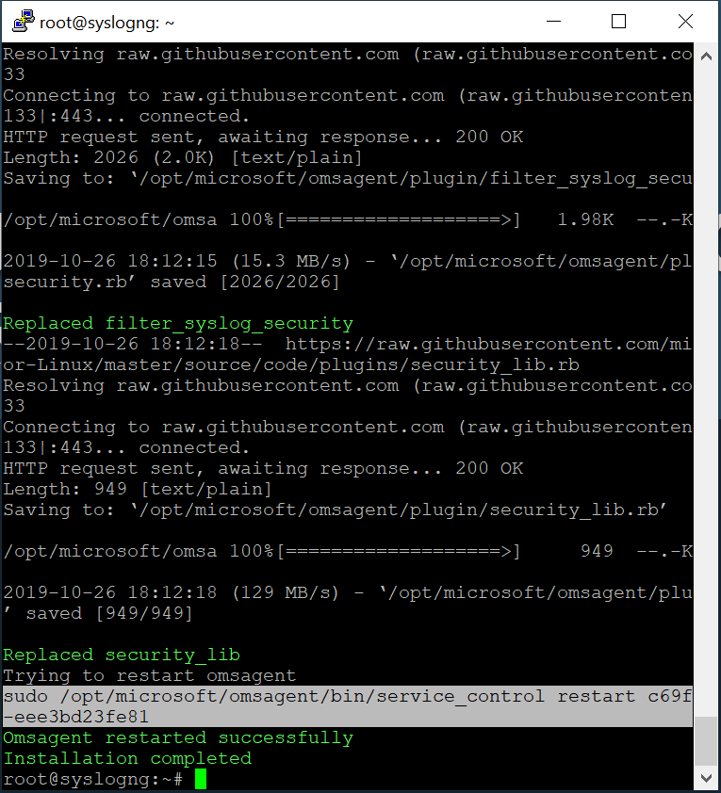
The completed outcome on syslog-ng and rsyslog

Slide 14
How to run the Python Troubleshooting script on a syslog server
There is a troubleshooting script to check the health of the Syslog Server and OMS Agent.
Command: sudo wget https://raw.githubusercontent.com/Azure/Azure-Sentinel/master/DataConnectors/CEF/cef_troubleshoot.py&& sudo python cef_troubleshoot.py <WorkspaceID>

Slide 15
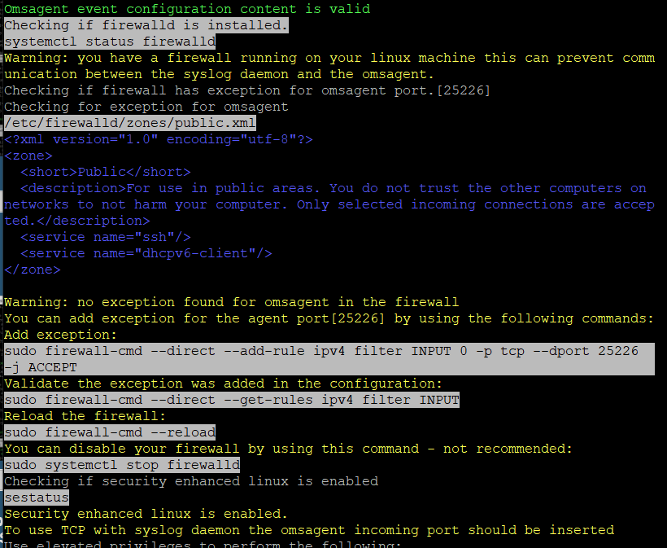
How to run the Python Troubleshooting script on a syslog server
In some cases, the IP Tables will block the connection to port 25226. So you will need to allow this access to allow syslog to open a port to 25226 for syslogs to flow to the OMS agent.

Slide 16
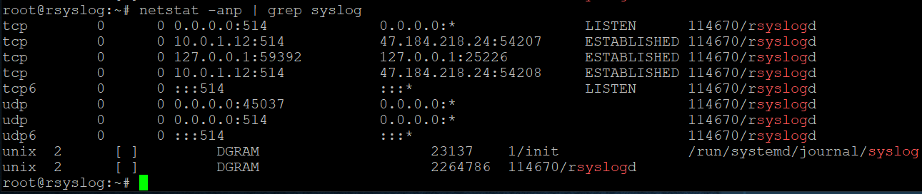
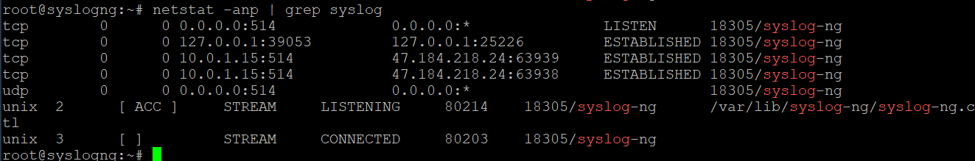
How to troubleshoot an existing Syslog Server and OMS Agent deployment
In rsyslog the netstat output should show established on port 514
Syslog listening on port 514
Netstat –anp | grep syslog
Syslog will open a port to 25226 to the localhost 127.0.0.1 this is required and if not working most times it’s an IP Tables issue.
In syslog-ng the netstat output should show established on port 514 also

Slide 17
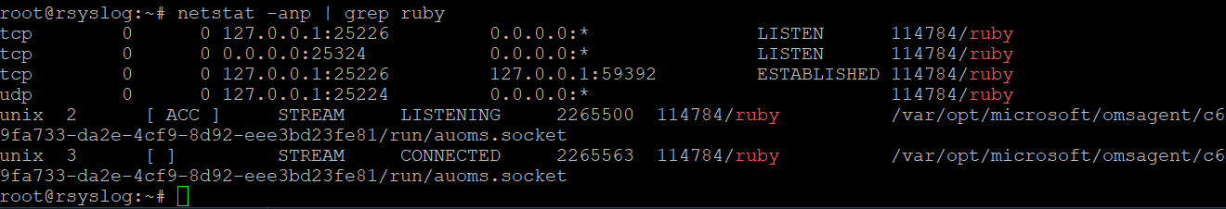
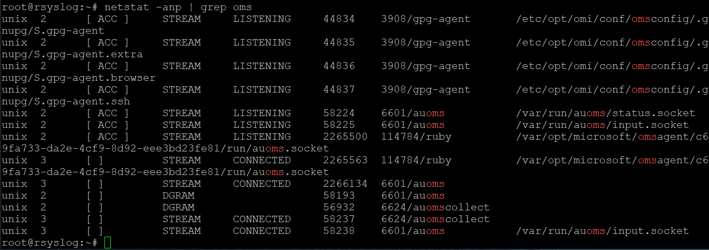
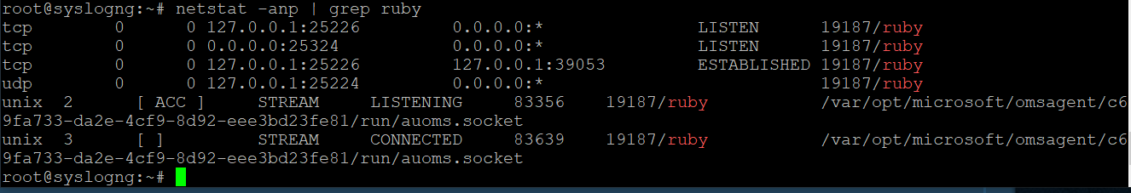
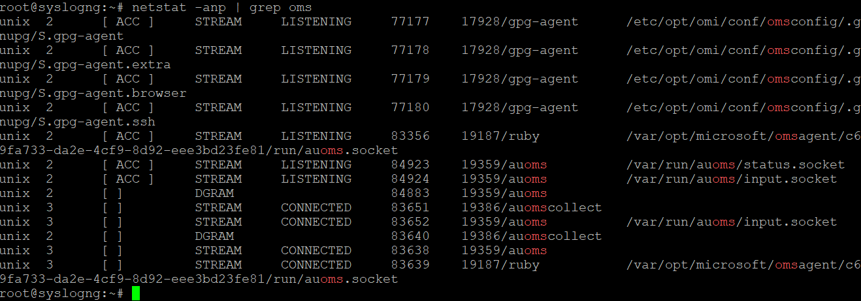
How to troubleshoot an existing Syslog Server and OMS Agent deployment
OMS Agent running and listening on port 25224 and port 25226
netstat –anp | grep ruby
Port 25244 and 25226 listening
The most important part of this is the established connection on port 25226
netstat –anp | grep oms
Many auoms ports listening

Slide 18
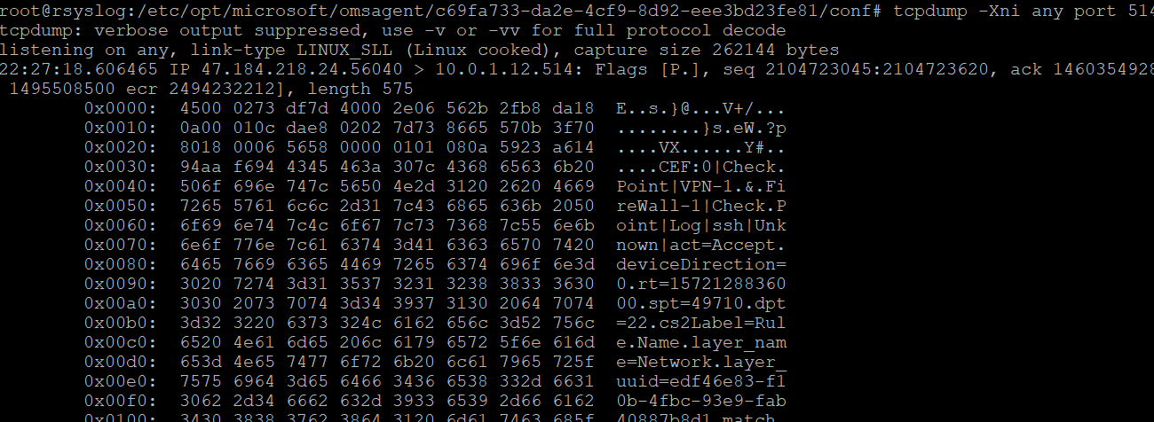
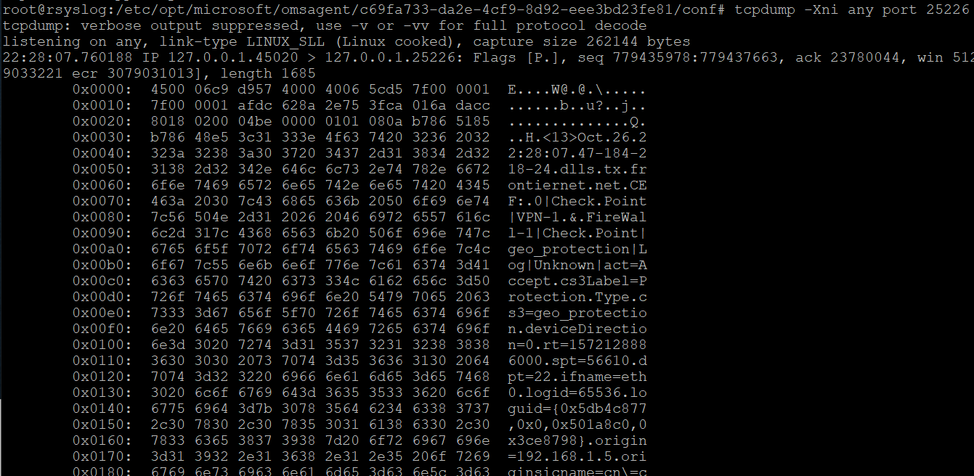
Are we receiving syslogs?
Syslogs received on port 514
tcpdump –Xni any port 514
Syslog received on port 25226
tcpdump –Xni any port 25226

Slide 19
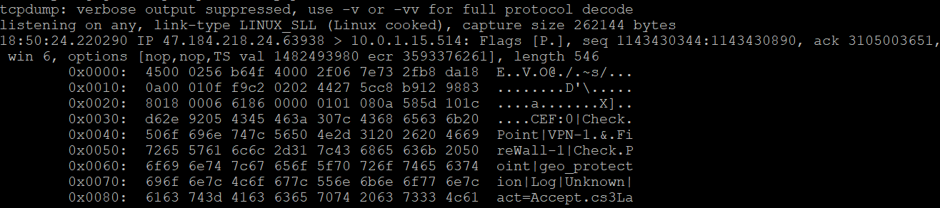
What type of logs are we receiving
This is a CEF syslog
Command:
tcpdump –Xni any port 514
Provides the complete packet output and we can determine the type of syslog we are receiving.

Slide 20
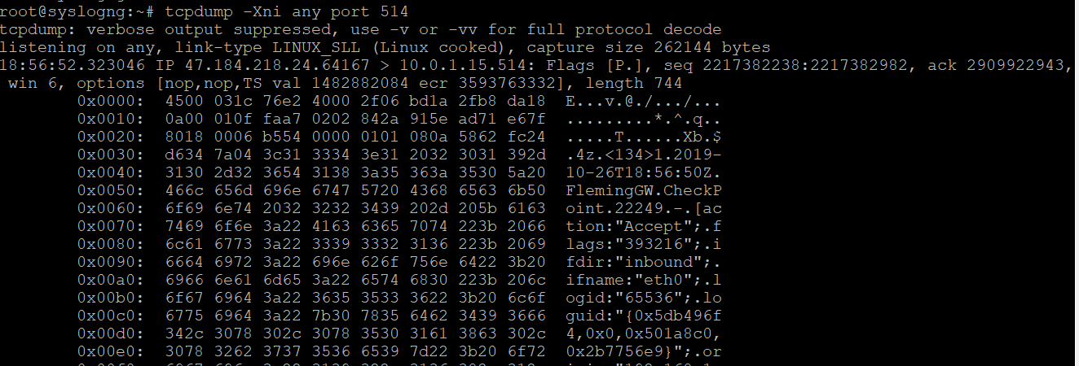
What type of logs are we receiving
Command: tcpdump –Xni any port 514
provides the complete packet output
This is a syslog log, notice there is no CEF:0 value, but we can determine the syslog facility from the value of its priority <###> in this case its 134.
How to calculate the facility of the syslog:
Priority = Facility * 8 + Level
Priority = 134
134/8 = 16.75 use the whole number
16 * 8 = 128 facility
134 -128 = 6 level
To determine what these value mean
https://en.wikipedia.org/wiki/Syslog
In this case, this is syslog local0 and the level is informational.

Slide 21
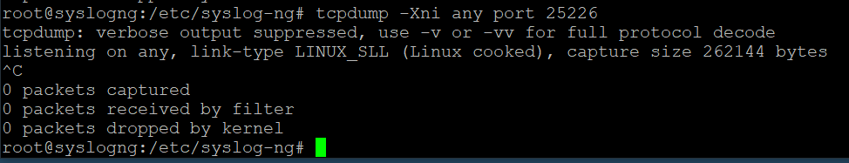
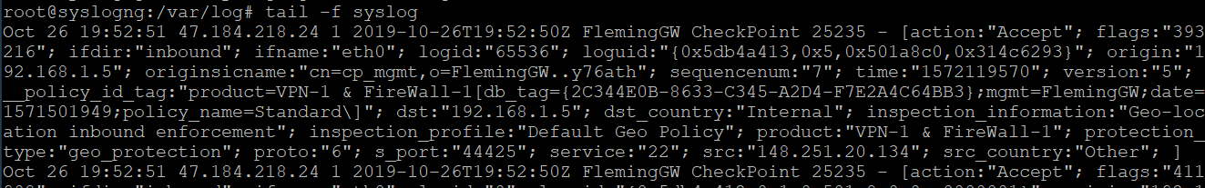
Are we filtering properly for the syslog type
If we run tcpdump –Xni any port 25226 and we do not see any packets than the filter for the logs is not correctly configured.
If the tcpdump does not show any packets, than the filter for the facility is incorrectly configured in the security_event_omsagent.conf file. Adding local0.info @127.0.0.1:25226 line to the file, and restarting rsyslog will correct the issue.
I am still working to figure out this issue, so far I have not been able to get syslogs local0.info to come into a syslog-ng server and forward to the OMS agent. I am working with the Program Manager to get this answered. With rsyslog this works fine no issues. Syslog local0.info will appear in Log Analytics Syslog workbook and alerts can be created.

Slide 22
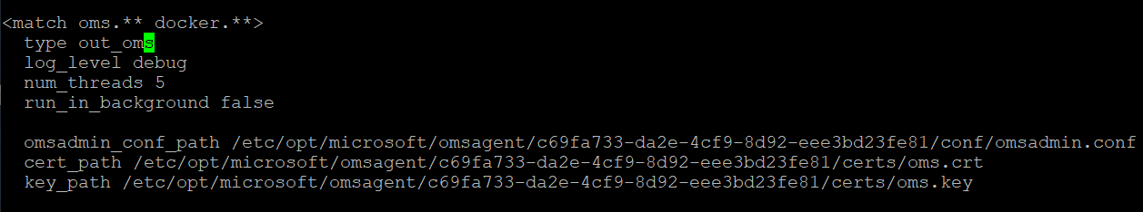
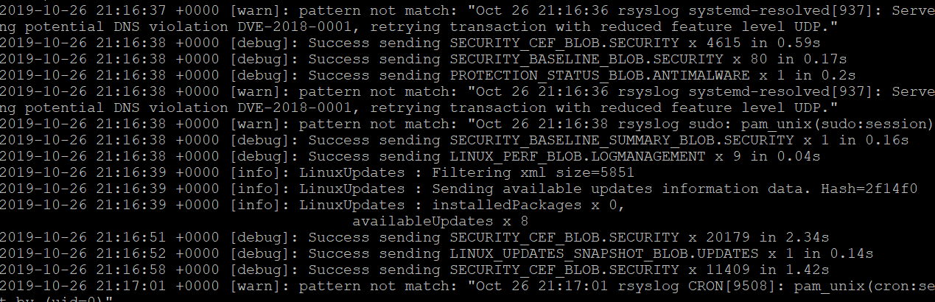
Debugging the OMS Agent and Syslog Server
We can change the OMS Agent and put it in debug mode.
vi or vim /etc/opt/microsoft/omsagent/<WorkspaceID>/conf/omsagent.conf
Change the value from info to debug
Save the changes and restart the oms agent.
Command:
tail –f /var/opt/microsoft/omsagent/log/omsagent.log
We want to see the success messages in the debugs SECURITY_CEF_BLOB.SECURITY x ### in ###s

Slide 23
Quiz
Which of the following is not supported operating system for the OMS Agent?
a. RedHat 7.2
b. CentOS 8.0
c. Ubuntu 18.3
d. Debian 8.0

Slide 24
Quiz
Which of the following can prevent the syslog logs to flow to Azure
a. Log Analytics Workspace set in Standard Tier
b. RedHat OS version 7.x
c. IP Tables blocking TCP port 25226
d. /etc/rsyslog.d/security_omsagent_config.conf file missing

Slide 25
Common Issues
Disk Partition ran out of space
df –ah – provided partition utilization
su –mh – Provides list of files and directories by size in megabytes
IP Tables blocking tcp port 25226
Logs are not CEF format
OMS Agent needs to be configured to accept local0,local4,syslog
Unsupported Operating system
Log Analytics is not in standard tier
Log Analytics has a cap set

Slide 26
Common Issues
OMS Agent has a invalid configuration applied
Check for missing solutions or plugins
Operating System is hardened
Palo Alto has the wrong template used to send CEF Logs
Fortigate is not configured to send logs correctly
No OMS Agent Heartbeat

